Slide 1



Introduction To Tensorflow
Workshop for NDSC 2019
Paul Yuan
yanchengyuanmath@gmail.com

Slide 2

Paul Yuan
Ph.D Candidate in Math
Co-founder of YiDu AI
Co-founder of Foreins
Independent Consultant
5+ Years Experiences in Machine Learning and Numerical Optimization with Top Publications in ICML, ICIP, etc.
Education
Ph.D Candidate in Math, NUS (2015 - Now)
B. S from University of Science and Technology of China(USTC)

Slide 3

Our Activities & Community
Activities:
Machine Learning Seminar
Industrial Talks
Interview with industry leader and academia researchers
Community:
Meetup: 900+ members
Wechat Group: 700+ members including Data Scientists, AI researchers, Financial specialists
Wechat official account: Thousand of followers
Training Program:
Master Data Science in 4 Week (Beginner’s Level)
Data Science Meets Deep Learning (NLP Module)
Data Science Meets Deep Learning (Computer Vision Module) (Coming Soon)
Industrial projects and internships
Incubated by:

Slide 4
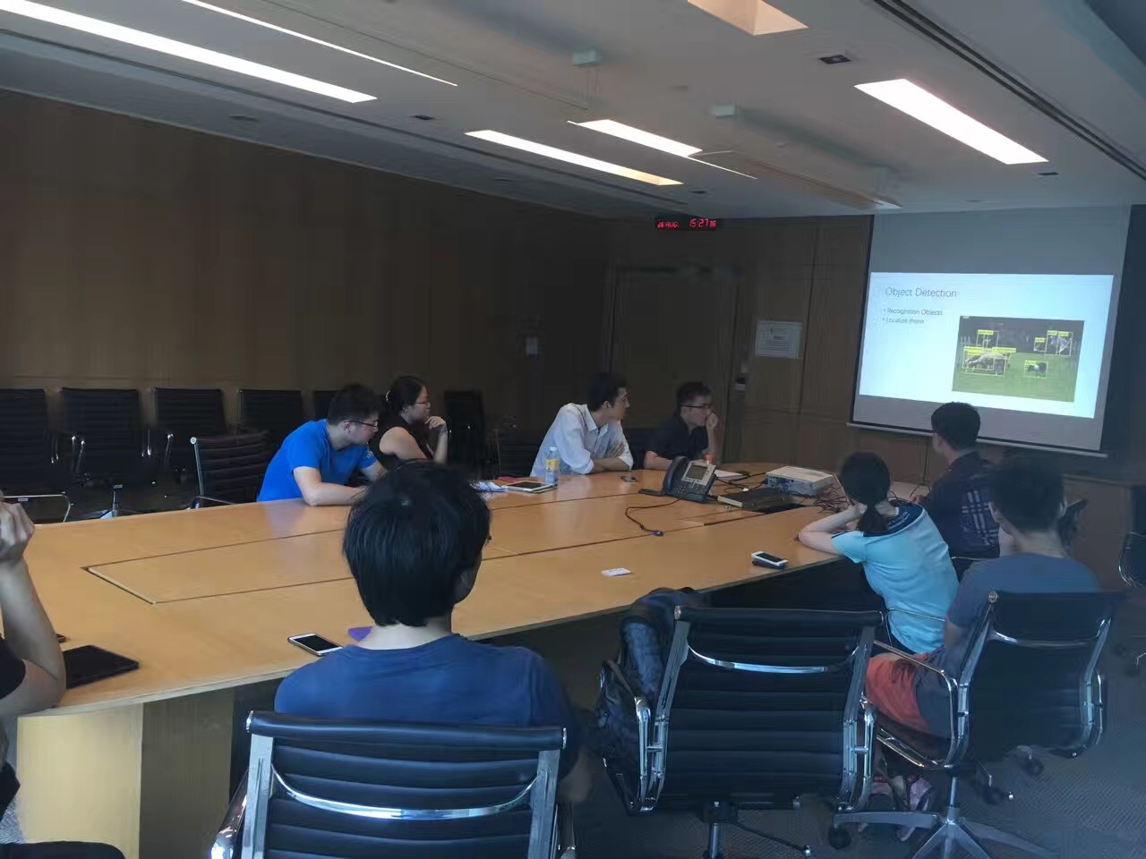
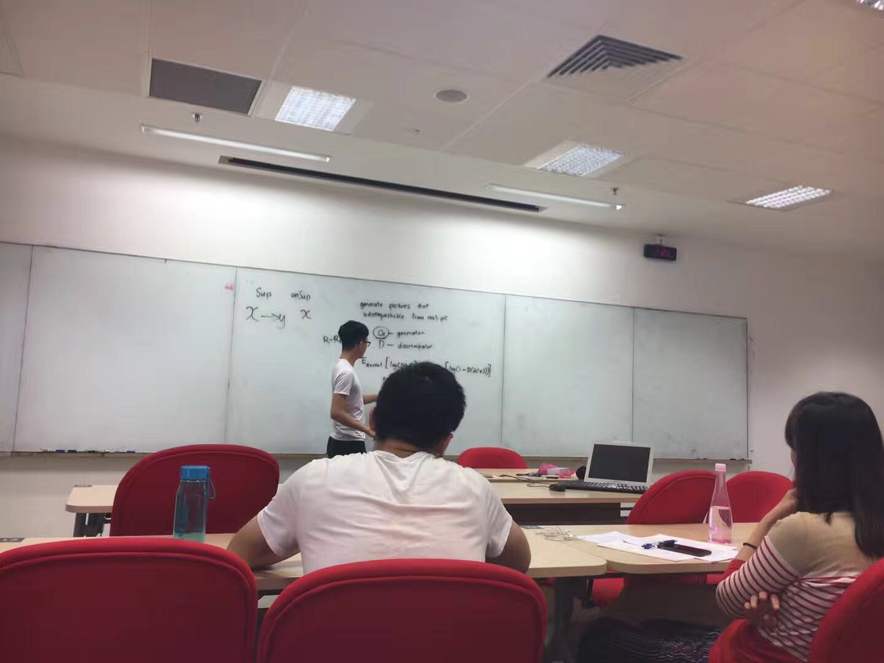
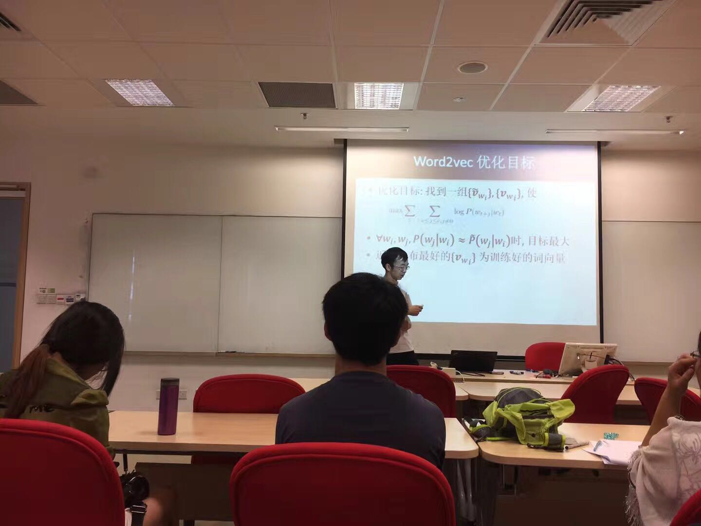
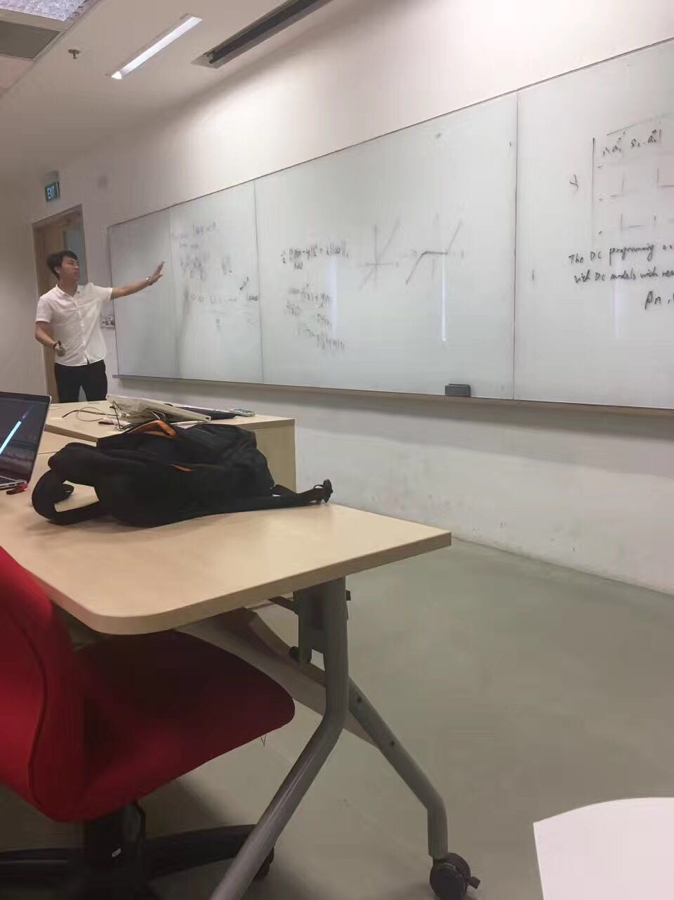
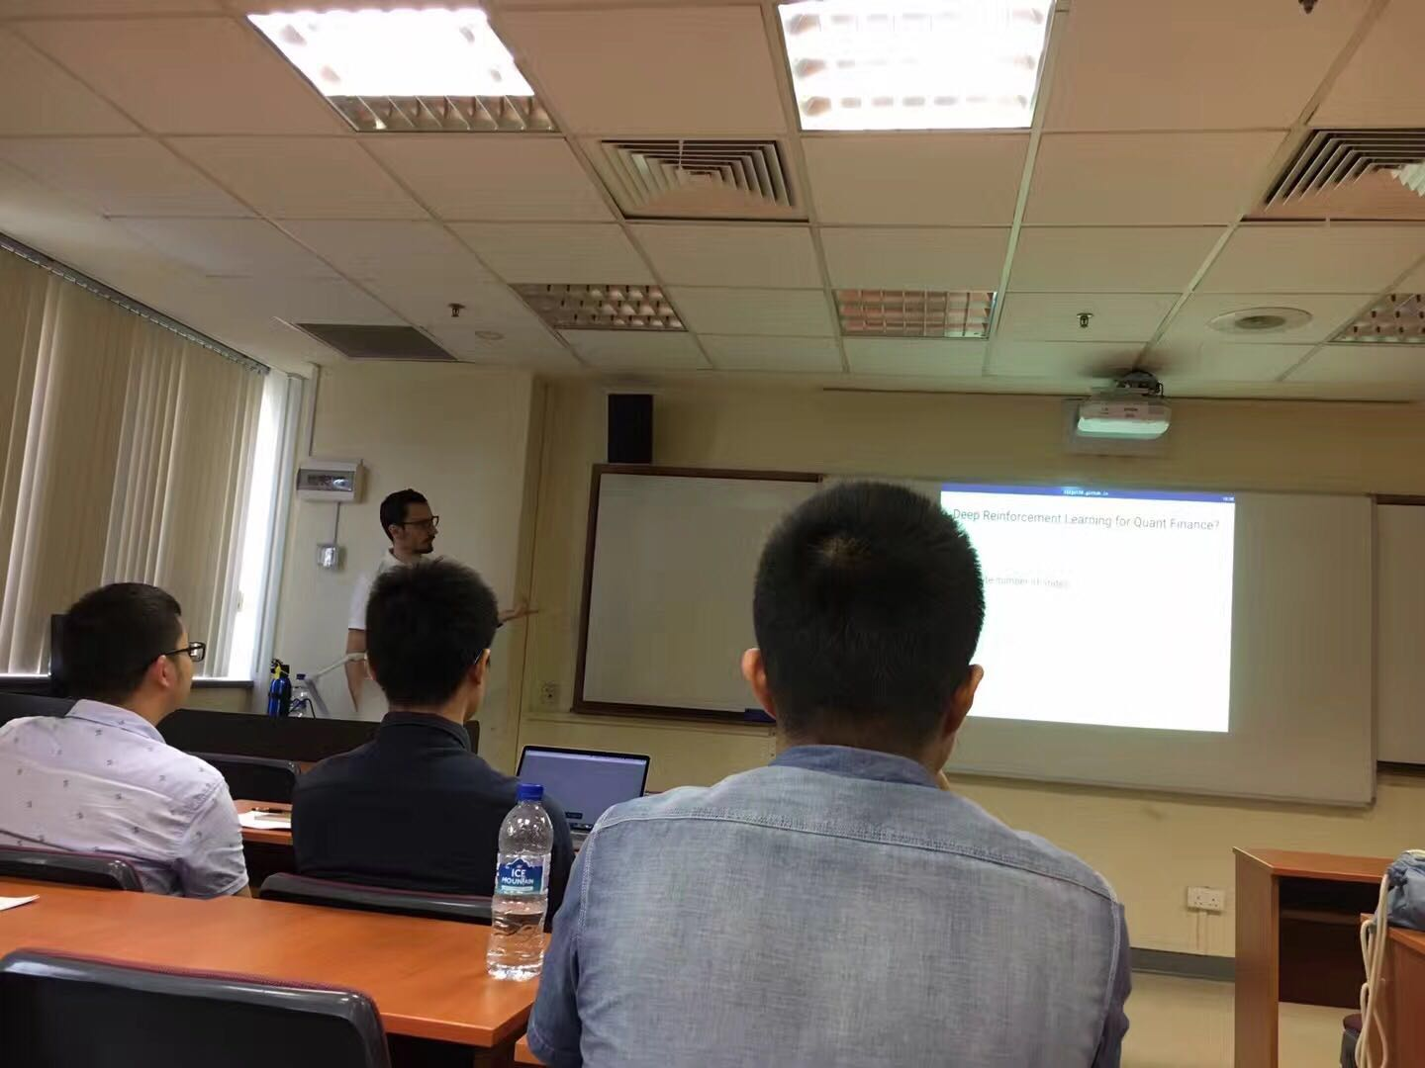
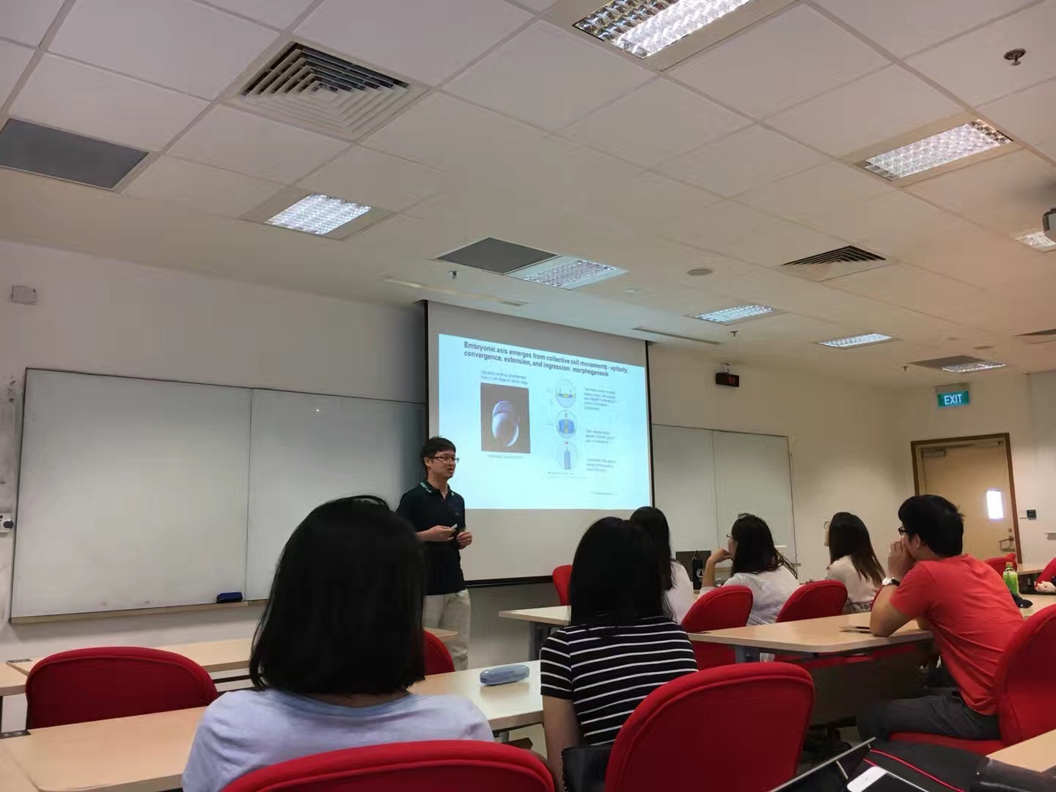
Past Machine Learning Seminars (50+)
Computer Vision
GAN (Generative Adversarial Networks)
NLP (Natural Language Processing)
Optimization
Fintech
AI in Medical Imaging
Hold regularly in NUS every weekend, with in total 600+ attendees
Invite excellent speakers like PhD students, researchers, industry employees.

Slide 5
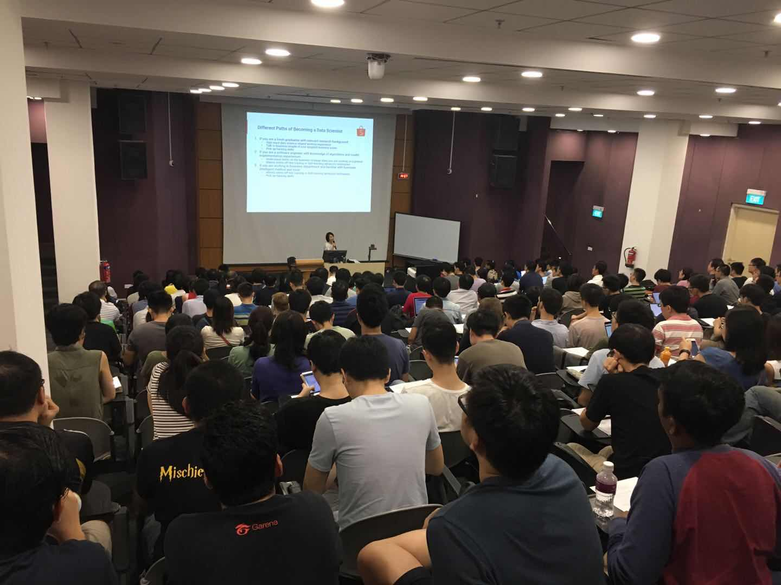
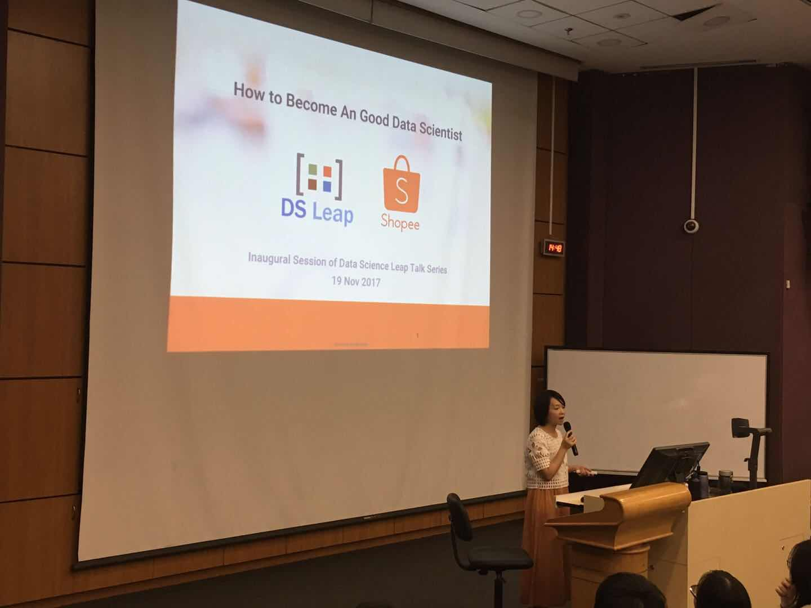
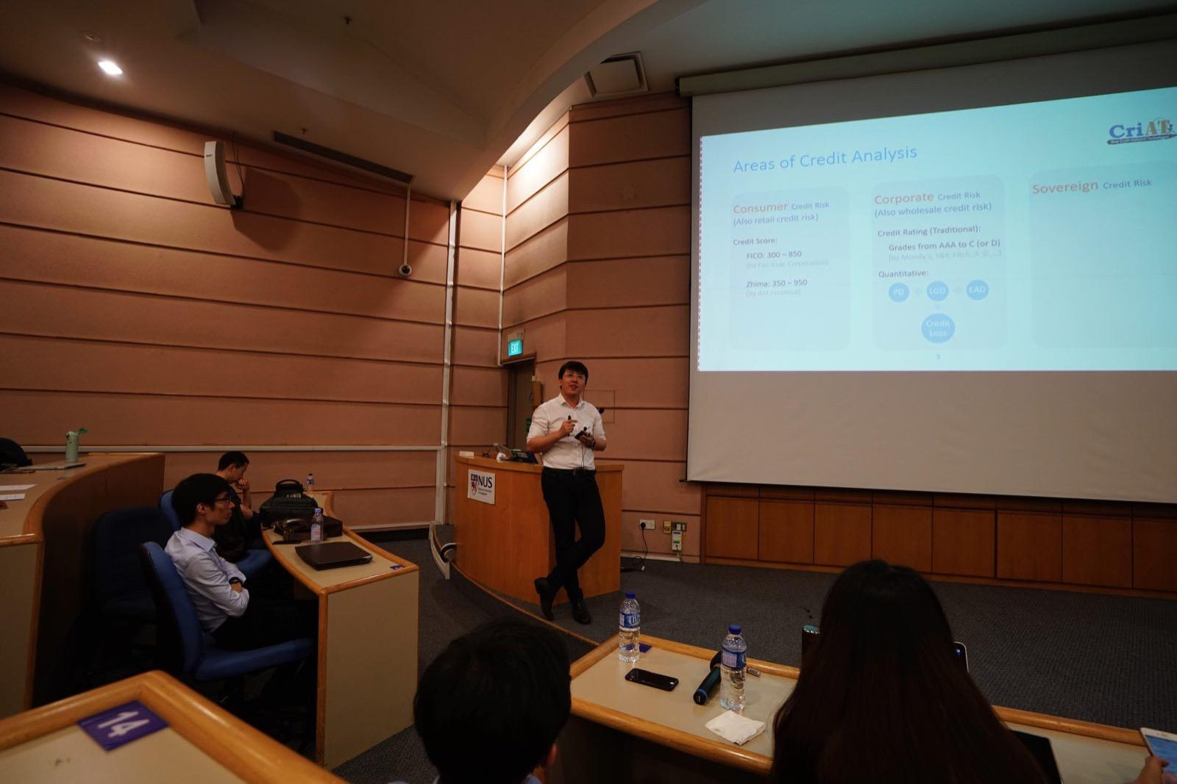
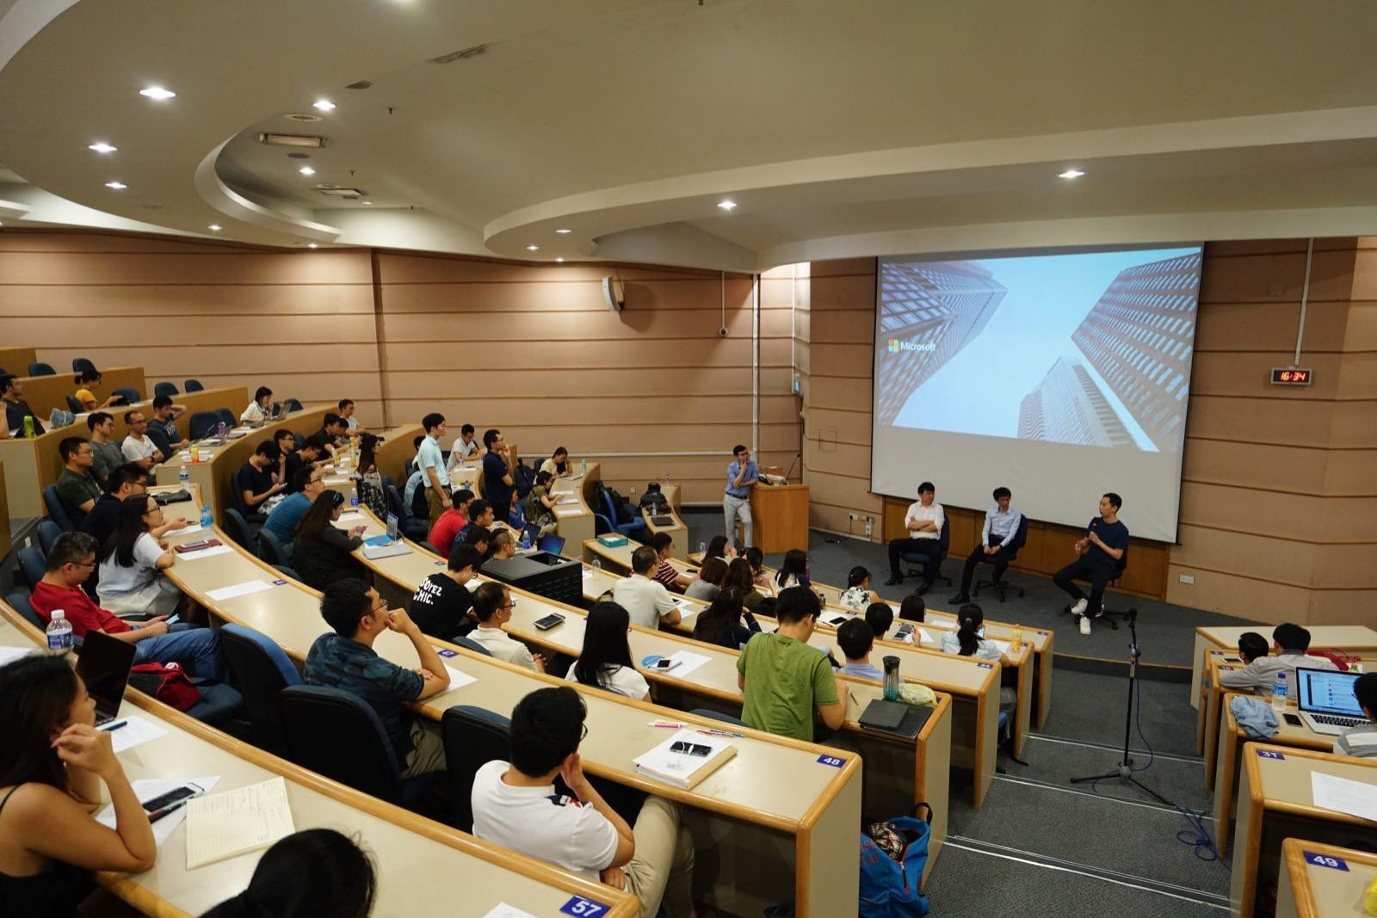
Past Industrial Talks
Over 1500 attendees
Sharing of cutting-edge applications and practical cases in industry
Attracted many students from NUS, NTU, SMU, SUTD etc., and lots of industry employees as well.

Slide 6

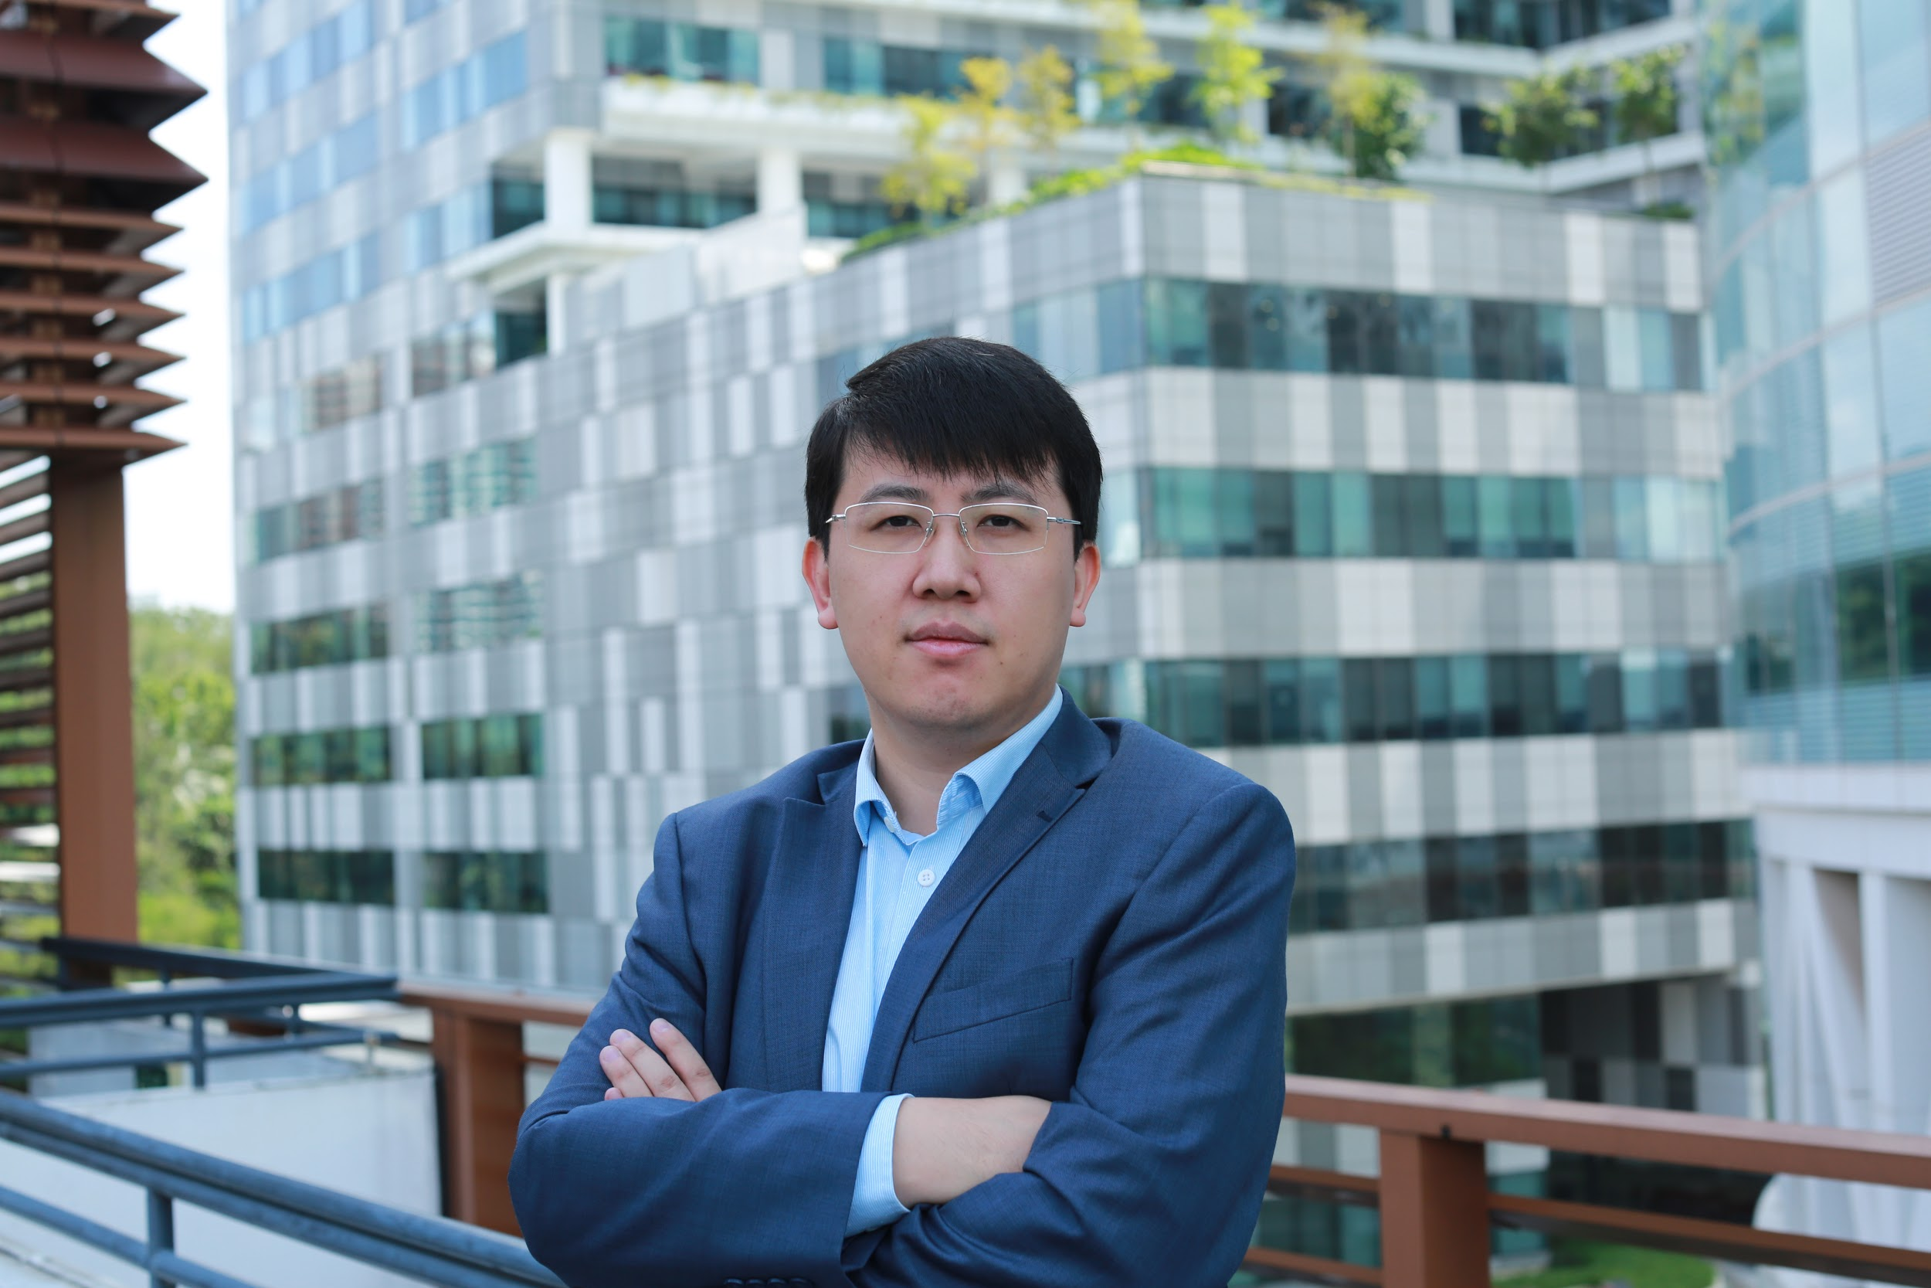
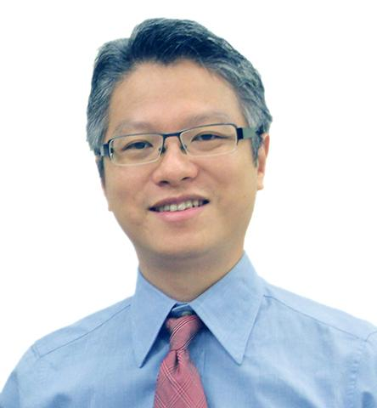
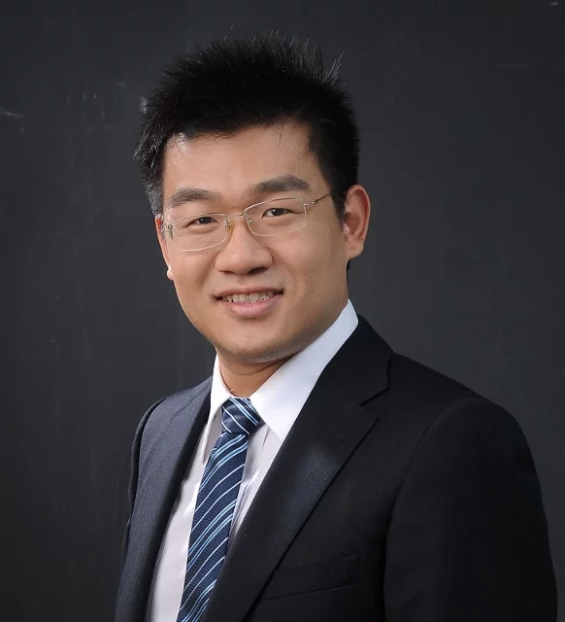
Interviews with AI Leaders
Dr. Pan Yaozhang
Head of Data Science Shopee
Dr. Miao Weimin
CEO
CriAT
Dr. Wen Yonggang
Associate Professor
NTU
Dr. Li Guangda
CTO
Visenze

Slide 7

Follow us on Meetup

Slide 8
Agenda
The Pipeline of Machine Learning
Introduction to Tensorflow
Keras
Hands-On

Slide 9
The Pipeline of Machine Learning Projects
Model Feedback Loop
User Behaviour
Train/Test Loop
Data Collection
Data Cleaning and Preprocessing
Model Selection and Training
Model Testing
Model Deployment and Integration

Slide 10
The Pipeline of Machine Learning Projects(Checklist)
Understand the problem and draw the big picture.
Get data.
Explore the data: gain some insights.
Data preprocessing and feature engineering.
Explore some reasonable machine learning models.
Finetune your models and combine them to form the best solution.
Well-document your solution.
Launch, monitor and maintain your system.

Slide 11

Step 0: Introduction to the Problem
What is the most important aspects for determining the price of a house?
With 79 explanatory variables describing (almost) every aspect of residential homes in Ames, Iowa, this competition challenges you to predict the final price of each home.

Slide 12
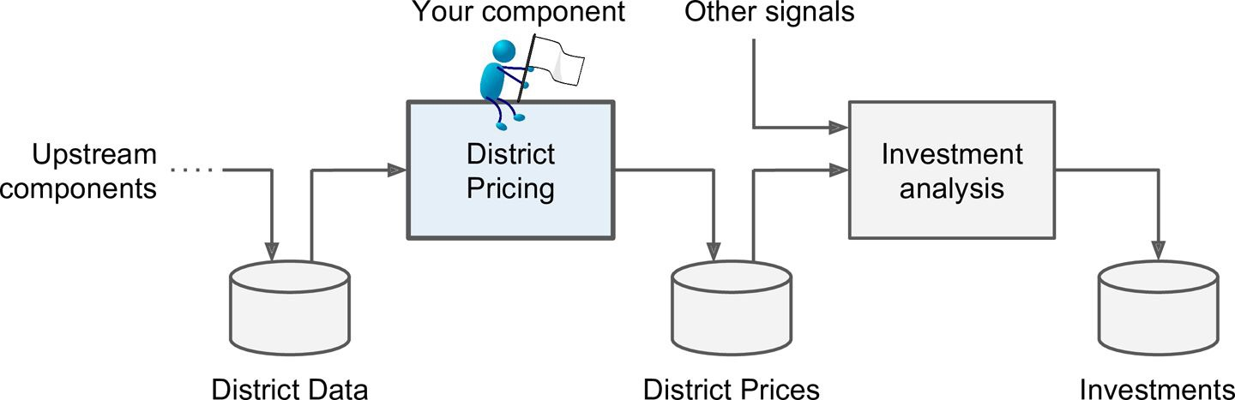
Step 0: The Big Picture

Slide 13
Step 0: The Big Picture
Data | The Sale Price and Related Information of the House
Label | The Sale Price of the House
Problem Type | Regression
Features | The Information of the house like: Location, Live Area, Quality
Model output | The Prediction of the Sale Price.

Slide 14
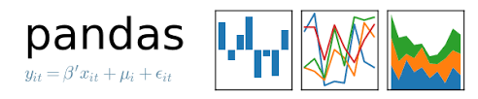
Step 1: Get Data
pandas is an open source, BSD-licensed library providing high-performance, easy-to-use data structures and data analysis tools for the Python programming language.
Import Pandas Library in Python:
Import pandas as pd
Load Data in Python Using Pandas:
train_data = pd.read_csv(‘File Directory’)

Slide 15
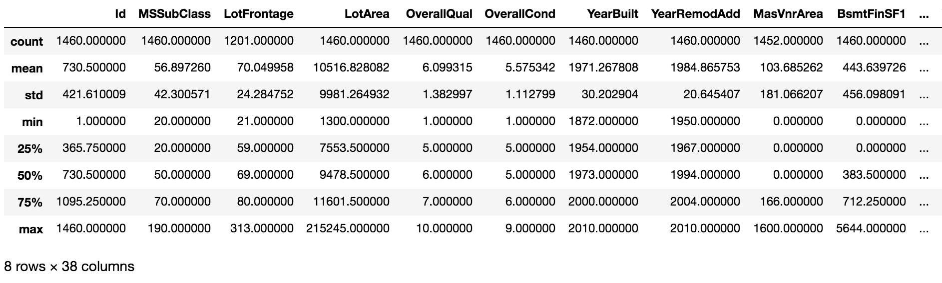
Step 2: Explore Data
Take a look at the data frame in one line of code. train_data.describe()

Slide 16
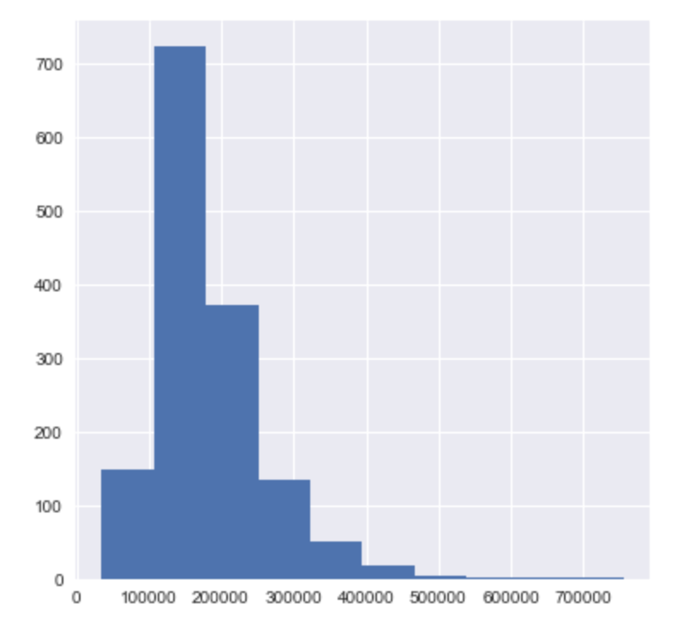
Step 2: Explore Data
2. Take a look at the distribution of target variable in one line of code. train_data[‘SalePrice’].hist()

Slide 17
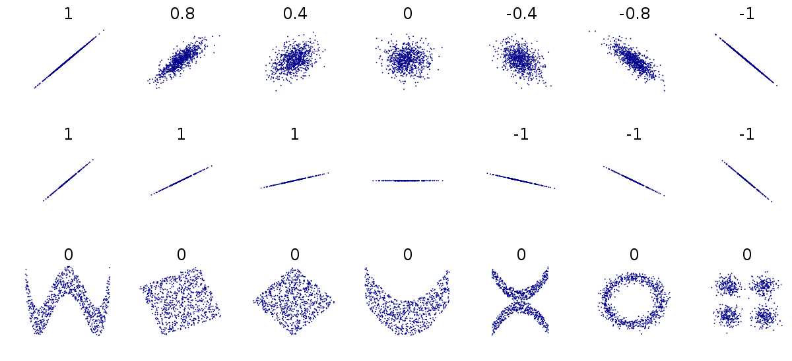
Step 2: Explore Data
3. Explore Relationships Between Features and Target Variable
What is Correlation between Two Random Variables?

Slide 18
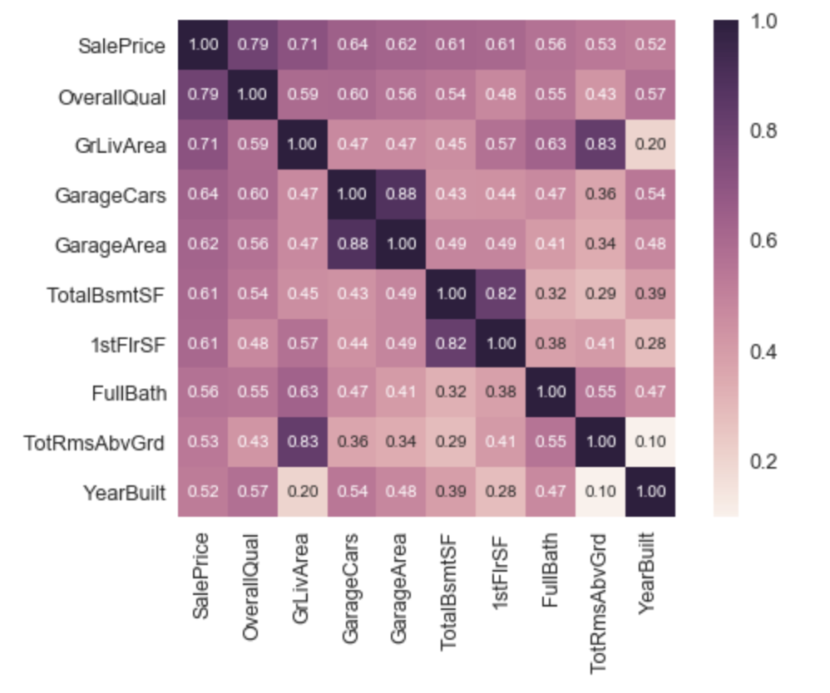
Step 2: Explore Data
3. Explore Relationships Between Features and Target Variable
Correlation Matrix Between Selected Features and Target Variables

Slide 19
Step 3: Data Preprocessing and Feature Engineering
1. Handle Categorical Features
Why handling Categorical Features?
Machine Learning Models can be fed only with numbers, not good at meaningless strings.
It’s not easy to measure the relationships between categorical variable.

Slide 20
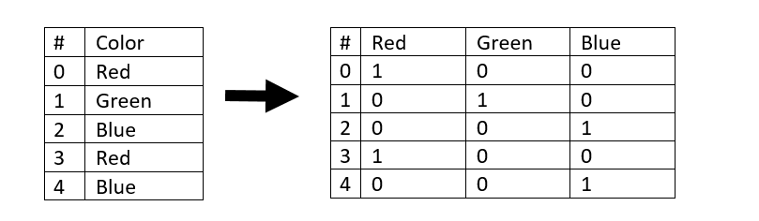
Step 3: Data Preprocessing and Feature Engineering
One-Hot Encoding.
Definition in Sci-kit Learn: “ Encode categorical integer features using a one-hot aka one-of-K scheme.”
Not that clear? Here is an example

Slide 21
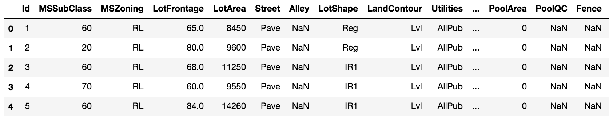
Step 3: Data Preprocessing and Feature Engineering
2. Handle Missing Data

Slide 22
Step 3: Data Preprocessing and Feature Engineering
2. Handle Missing Data → Imputation
Imputation is replacing missing values with substitute values. The following methods use some form of imputation.
Average Imputation
Common-Point Imputation
Median Imputation

Slide 23
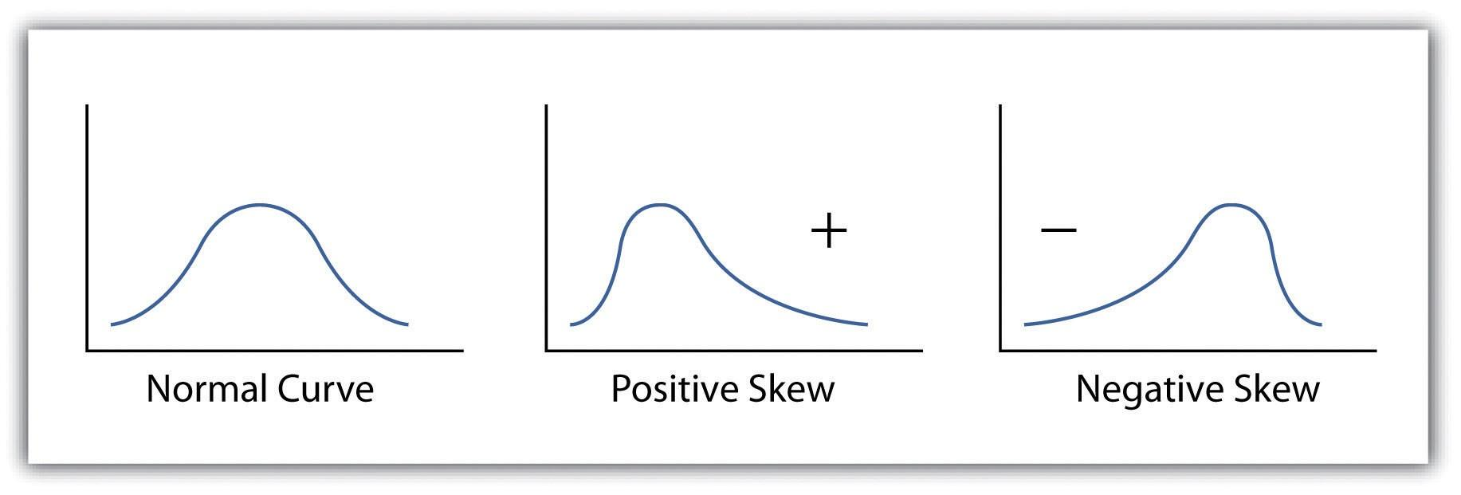
Step 3: Data Preprocessing and Feature Engineering
3. Handle Skewed Data

Slide 24
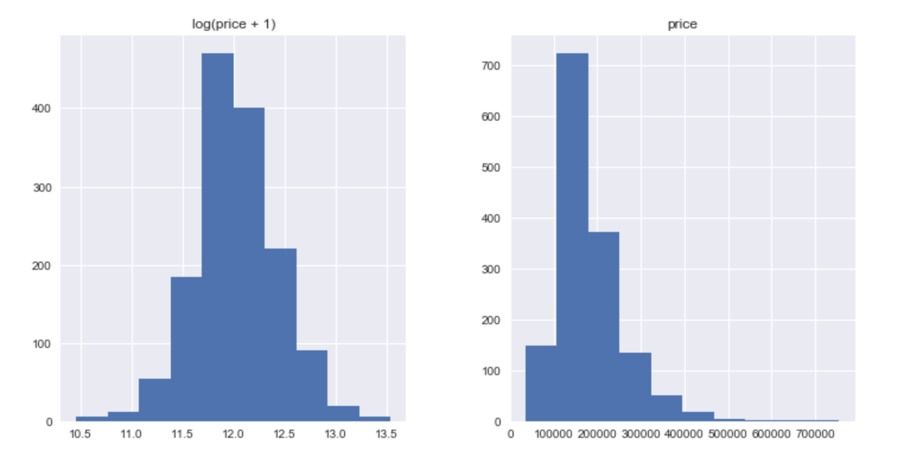
Step 3: Data Preprocessing and Feature Engineering
3. Handle Skewed Data
Positive Skewed Data: Take a log transform: log(1+x)

Slide 25
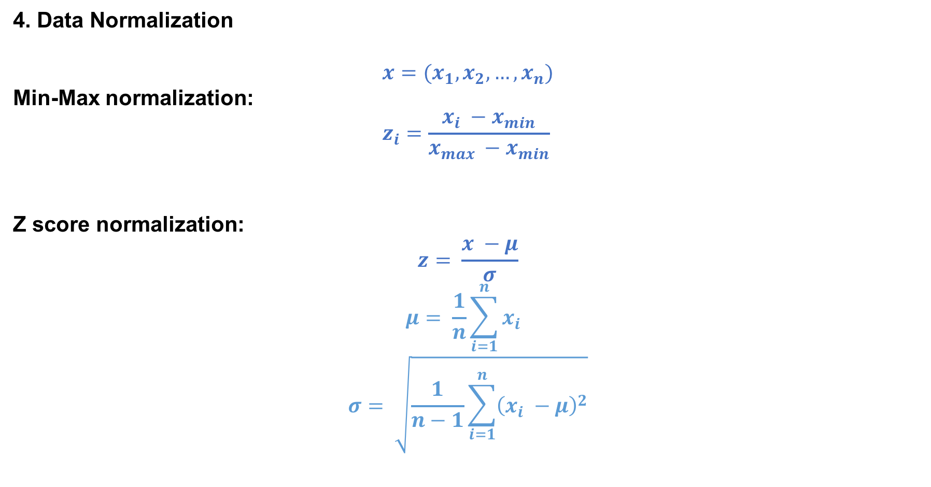
Step 3: Data Preprocessing and Feature Engineering

Slide 26
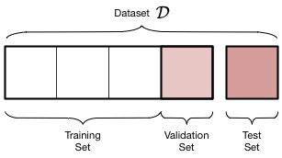
Step 3: Data Preprocessing and Feature Engineering
5. Split Dataset into Training Set and Validation Set in One Line of Code
from sklearn.cross_validation import train_test_split
X_train, X_test, y_train, y_test = train_test_split(X_train, y_train, test_size = 0.2, random_state = 42)

Slide 27
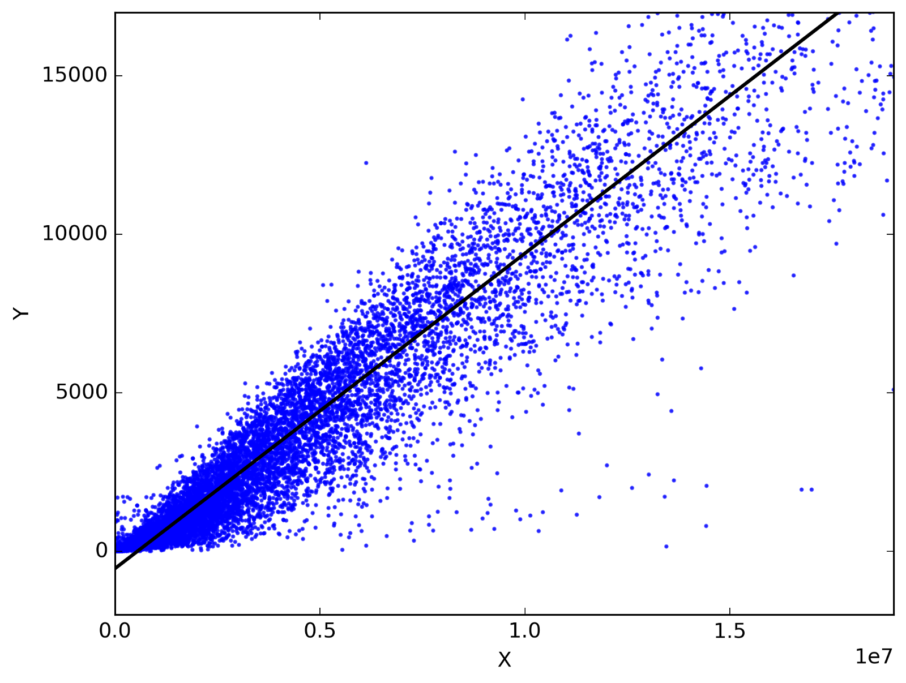
Step 4: Explore Reasonable Models
Linear Regression Model

Slide 28
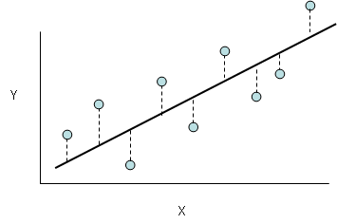
Step 4: Explore Reasonable Models
Root Mean Square Error(RMSE)

Slide 29

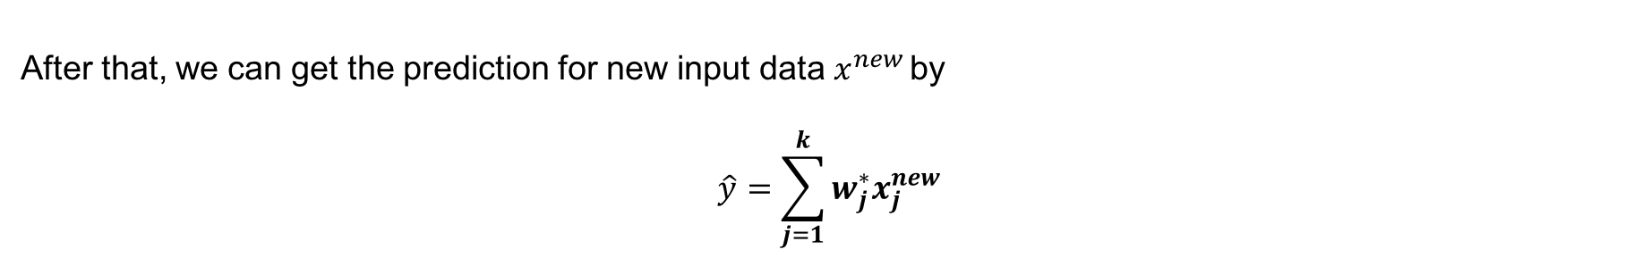
Step 4: Explore Reasonable Models
Linear Regression Model

Slide 30
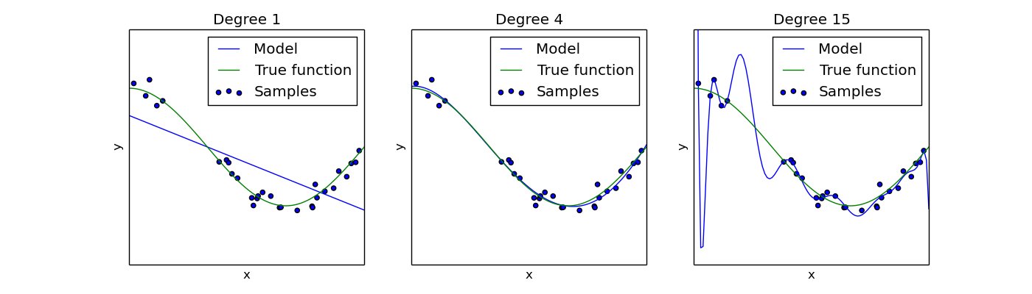
Step 4: Explore Reasonable Models
Regularization: Over- fitting

Slide 31
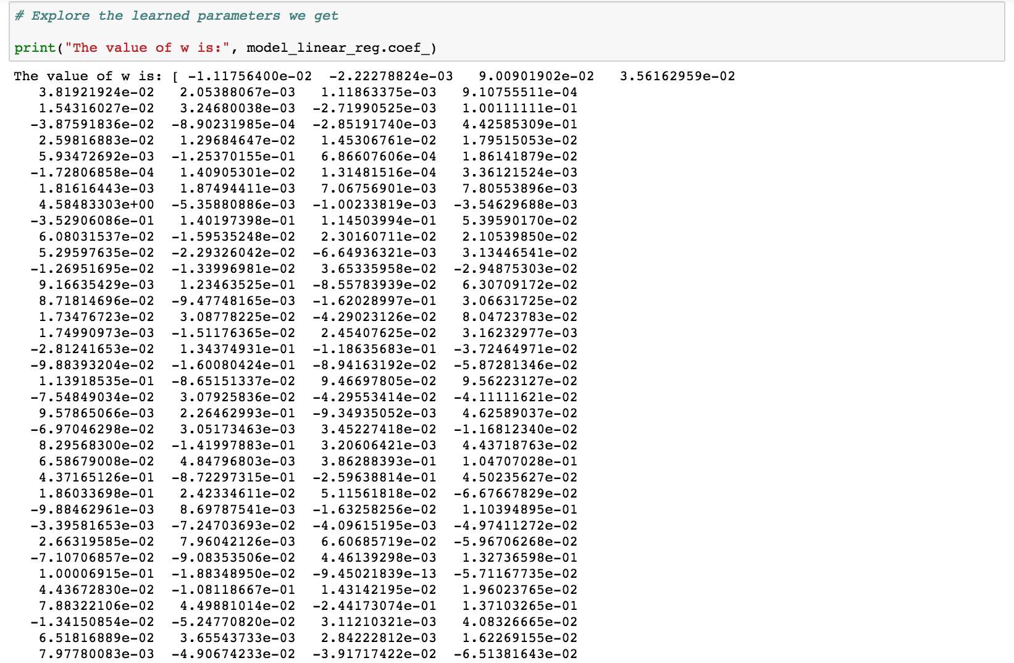
Step 4: Explore Reasonable Models
Regularization: Feature Selection

Slide 32
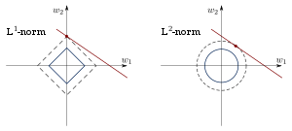
Step 4: Explore Reasonable Models
Regularization: Feature Selection

Slide 33

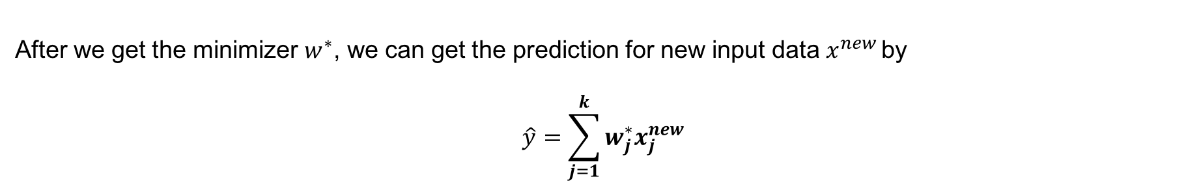
Step 4: Explore Reasonable Models
Lasso Model

Slide 34
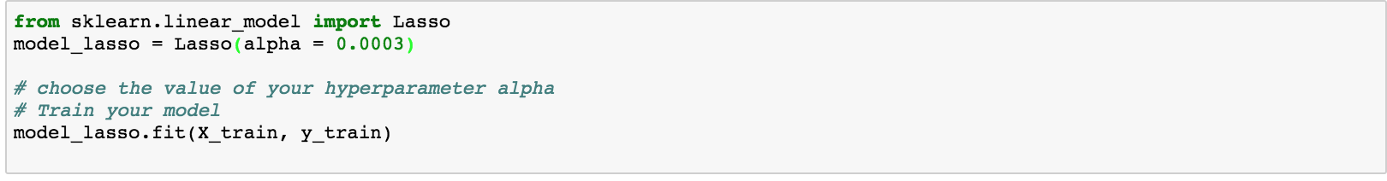
Step 4: Explore Reasonable Models
Try Lasso Model

Slide 35
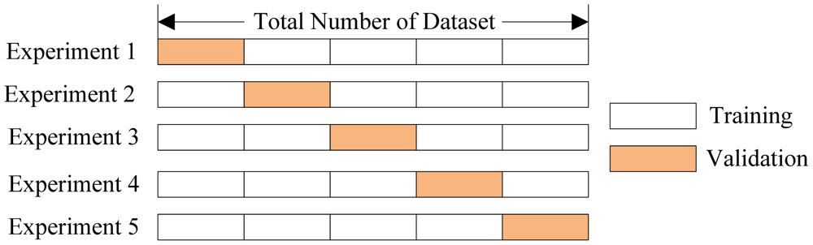
Step 4: Explore Reasonable Models
Cross-Validation

Slide 36
Step 5: Finetune Your Machine Learning Model
Now, Suppose you have a short list of promising models, you need to fine-tune them to get a better one.
Hyper-parameter Tuning 1. Try some discrete values to determine the rough range of the hyper-parameters. 2. Use Grid Search or Random Search to fine tune your hyper-parameters in the range
Model Ensemble(Will Cover in Week 3)

Slide 37
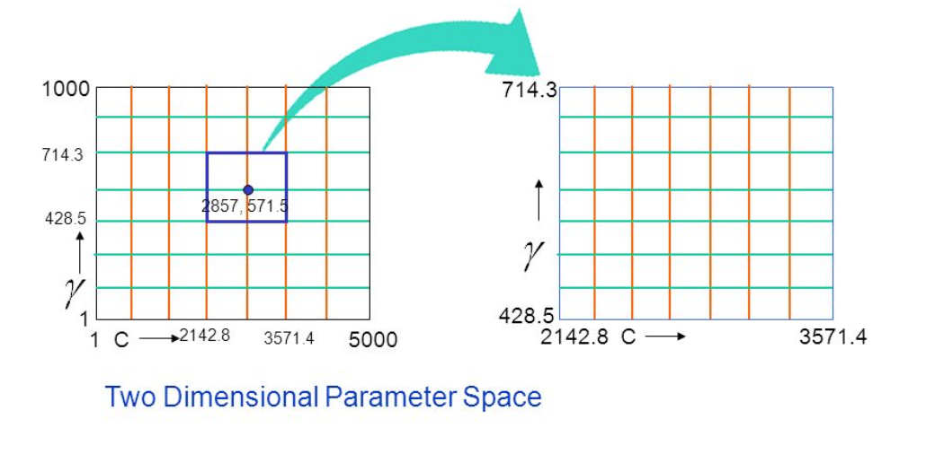
Step 5: Finetune Your Machine Learning Model
Grid Search
Search the best hyper-parameters set over an initial guess
Zoom into the best hyper-parameter grid, and do grid search again
Can employ the log-scale for better search

Slide 38

Tensorflow

Slide 39
Introduction to Tensorflow
Why Tensorflow ?
Computational Graph and Sessions
Basic Operations in Tensorflow
Auto-Diff and Optimizers
Visualization
Examples
Model Management

Slide 40

What is Tensorflow?
“Open source software library for numerical computation using data flow graphs”

Slide 41
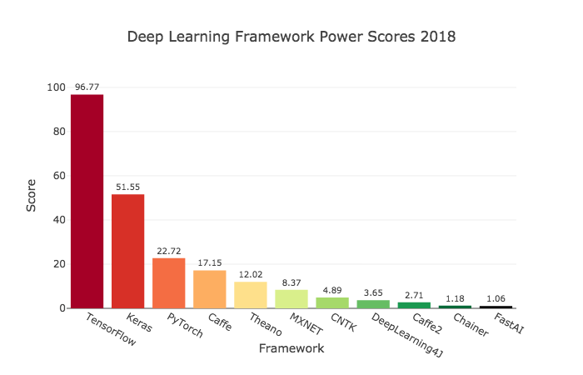
Why Tensorflow?
Flexibility + Scalability Originally developed by Google as a single infrastructure for machine learning in both production and research.
Popularity
Strong Community

Slide 42
Let’s Start
import tensorflow as tf

Slide 43
Agenda
Why Tensorflow ?
Computational Graph and Sessions
Basic Operations in Tensorflow
Auto-Diff and Optimizers
Visualization
Examples
Model Management

Slide 44
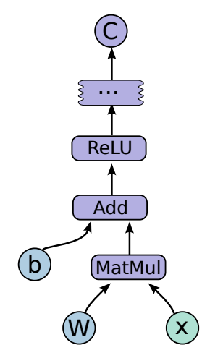
Graphs and Session
TensorFlow separates definition of computations from their execution
Graph from Google

Slide 45
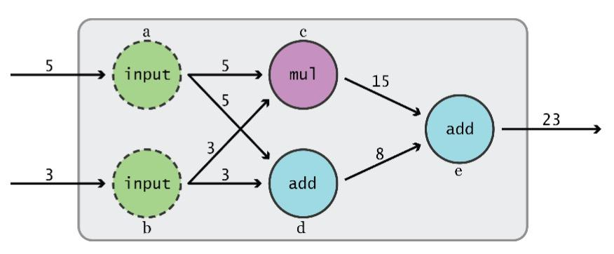
Philosophy of Tensorflow Design
(Before TF 2.0)
Phase 1: assemble a graph
Phase 2: use a session to execute operations in the graph.
Graph from TensorFlow for Machine Intelligence

Slide 46
Tensor
An n-dimensional array
0-d tensor: scalar (number)
1-d tensor: vector [1, 2, 3]
2-d tensor: matrix [[1,2],[3,4]]
n-d tensor

Slide 47
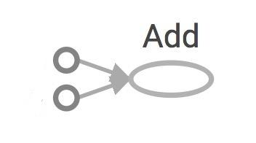

Construct Computational Graph
import tensorflow as tf a = tf.add(3, 5)
Nodes: operators, variables, and constants
Edges: tensors
Tensors are data.
TensorFlow = tensor + flow = data + flow
(I know, mind=blown)
3
a
5
Gif from CS20

Slide 48
Get the Value?
import tensorflow as tf a = tf.add(3, 5) print(a)
>> Tensor("Add:0", shape=(), dtype=int32)
(Not 8)

Slide 49
How to get 8 ?
Create a session, assign it to variable sess so we can call it later
Within the session, evaluate the graph to fetch the value of a

Slide 50
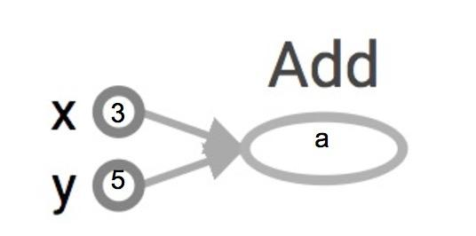
Hot to get 8 ?
Create a session, assign it to variable sess so we can call it later
Within the session, evaluate the graph to fetch the value of a
import tensorflow as tf a = tf.add(3, 5) sess = tf.Session() print(sess.run(a)) sess.close()
>> 8
visualization via Tensorboard

Slide 51
A Better Way to Use tf.session()
Create a session, assign it to variable sess so we can call it later
Within the session, evaluate the graph to fetch the value of a
import tensorflow as tf a = tf.add(3, 5) sess = tf.Session() with tf.Session() as sess: print(sess.run(a)) sess.close()
visualization via Tensorboard

Slide 52
tf.Session()
A Session object encapsulates the environment in which Operation objects are executed, and Tensor objects are evaluated.
Session will also allocate memory to store the current values of variables.

Slide 53
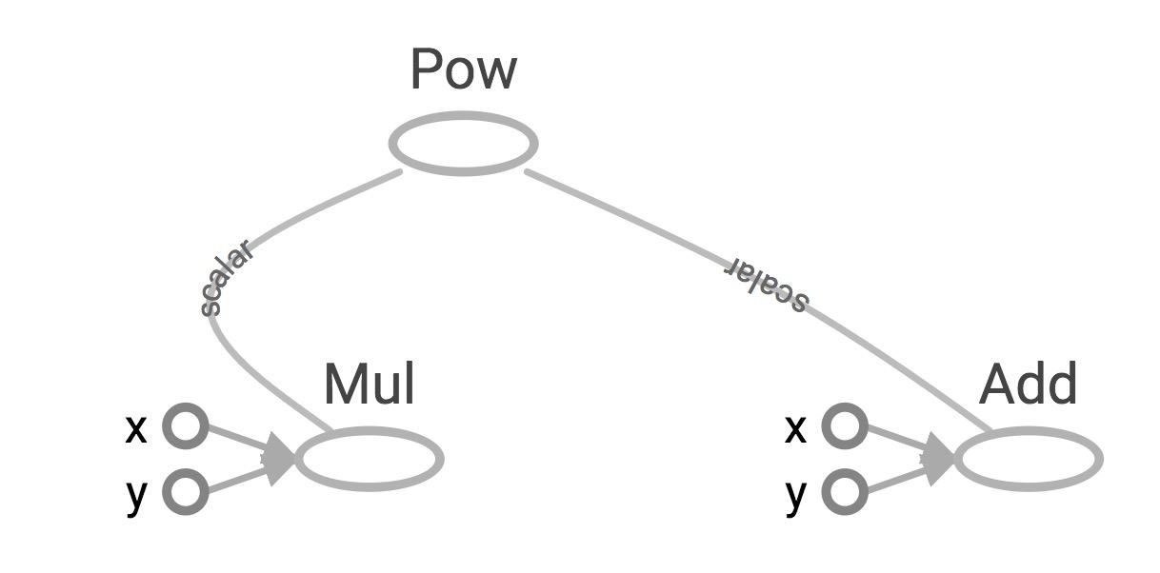
One More Example
import tensorflow as tf x = 2 y = 3 op1 = tf.add(x, y) op2 = tf.multiply(x, y) op3 = tf.pow(op2, op1) with tf.Session() as sess: op3 = sess.run(op3)
visualization via Tensorboard

Slide 54
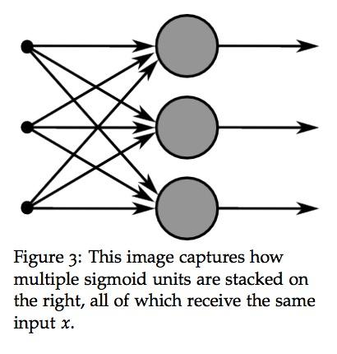
Why Computational Graphs ?
Save computation. Only run subgraphs that lead to the values you want to fetch.
Break computation into small, differential pieces to facilitate auto-differentiation
Facilitate distributed computation, spread the work across multiple CPUs, GPUs, TPUs, or other devices
Many common machine learning models are taught and visualized as directed graphs
Example from CS 20

Slide 55
Agenda
Why Tensorflow ?
Computational Graph and Sessions
Basic Operations in Tensorflow
Auto-Diff and Optimizers
Visualization
Examples
Model Management

Slide 56
Constants
import tensorflow as tf
a = tf.constant([2, 2], name='a') b = tf.constant([[0, 1], [2, 3]], name='b') x = tf.multiply(a, b, name='mul')
with tf.Session() as sess: print(sess.run(x))
>> [[0 2]
[4 6]]

Slide 57
Constant Generators
tf.zeros(shape, dtype=tf.float32, name=None)
tf.zeros([2, 3], tf.int32) ==> [[0, 0, 0], [0, 0, 0]]
tf.zeros_like(input_tensor, dtype=None, name=None, optimize=True)
# input_tensor is [[0, 1], [2, 3], [4, 5]]
tf.zeros_like(input_tensor) ==> [[0, 0], [0, 0], [0, 0]]
tf.ones(shape, dtype=tf.float32, name=None)
tf.fill(dims, value, name=None)

Slide 58
Random Constant Generators
tf.random_normal
tf.truncated_normal
tf.random_uniform
tf.random_shuffle
tf.random_crop
tf.multinomial
tf.random_gamma

Slide 59
TF DType Vs Numpy
TensorFlow integrates seamlessly with NumPy
tf.int32 == np.int32 # ⇒ True
Can pass numpy types to TensorFlow ops
tf.ones([2, 2], np.float32) # ⇒ [[1.0 1.0], [1.0 1.0]]
For tf.Session.run(fetches): if the requested fetch is a Tensor , output will be a NumPy ndarray.
sess = tf.Session()
a = tf.zeros([2, 3], np.int32)
print(type(a))
a = sess.run(a) <<<< Avoid doing this. Use a_out = sess.run(a)
print(type(a))

Slide 60
Use TF DType if Possible
Python native types: TensorFlow has to infer Python type
NumPy arrays: NumPy is not GPU compatible

Slide 61
Why Constants are NOT Good Enough?
Constants are stored in the graph definition

Slide 62
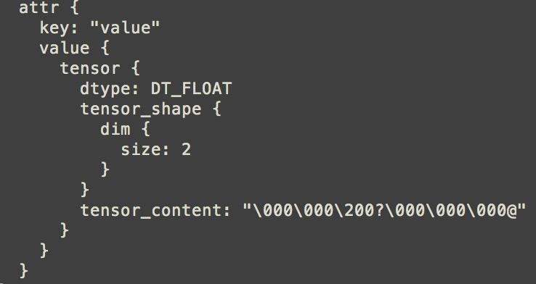
my_const = tf.constant([1.0, 2.0], name="my_const")
with tf.Session() as sess: print(sess.graph.as_graph_def())

Slide 63

Variables
# create variables with tf.Variable
s = tf.Variable(2, name="scalar")
m = tf.Variable([[0, 1], [2, 3]], name="matrix")
W = tf.Variable(tf.zeros([784,10]))
# create variables with tf.get_variable
s = tf.get_variable("scalar", initializer=tf.constant(2))
m = tf.get_variable("matrix", initializer=tf.constant([[0, 1], [2, 3]]))
W = tf.get_variable("big_matrix", shape=(784, 10), initializer=tf.zeros_initializer())

Slide 64
Initialize Your Variables
The easiest way is initializing all variables at once:
with tf.Session() as sess:
sess.run(tf.global_variables_initializer())
Initialize only a subset of variables:
with tf.Session() as sess:
sess.run(tf.variables_initializer([a, b]))
Initialize a single variable
W = tf.Variable(tf.zeros([784,10]))
with tf.Session() as sess:
sess.run(W.initializer)
Initializer is an op. You need to execute it within the context of a session.

Slide 65
tf.Variable is a Class
tf.Variable is a class with many operations.
x = tf.Variable(...)
x.initializer # init op
x.value() # read op
x.assign(...) # write op
x.eval() # evaluate op

Slide 66
Placeholders
A TF program often has 2 phases:
Assemble a graph
Use a session to execute operations in the graph.
⇒ Assemble the graph first without knowing the values needed for computation
Analogy:
Define the function f(x, y) = 2 * x + y without knowing value of x or y.
x, y are placeholders for the actual values.

Slide 67
Why Placeholders ?
We, or our clients, can later supply their own data when they need to execute the computation.

Slide 68
Placeholders
tf.placeholder(dtype, shape=None, name=None)
# create a placeholder for a vector of 3 elements, type tf.float32
a = tf.placeholder(tf.float32, shape=[3])
b = tf.constant([5, 5, 5], tf.float32)
# use the placeholder as you would a constant or a variable
c = a + b # short for tf.add(a, b)
with tf.Session() as sess:
print(sess.run(c)) # >> ???

Slide 69
Placeholders
tf.placeholder(dtype, shape=None, name=None)
# create a placeholder for a vector of 3 elements, type tf.float32
a = tf.placeholder(tf.float32, shape=[3])
b = tf.constant([5, 5, 5], tf.float32)
# use the placeholder as you would a constant or a variable
c = a + b # short for tf.add(a, b)
with tf.Session() as sess:
print(sess.run(c)) # >> InvalidArgumentError: a doesn’t an actual value

Slide 70
Feed Your Placeholders with Data
tf.placeholder(dtype, shape=None, name=None)
# create a placeholder for a vector of 3 elements, type tf.float32
a = tf.placeholder(tf.float32, shape=[3])
b = tf.constant([5, 5, 5], tf.float32)
# use the placeholder as you would a constant or a variable
c = a + b # short for tf.add(a, b)
with tf.Session() as sess:
print(sess.run(c, feed_dict={a: [1, 2, 3]}))
# >> [6, 7, 8]

Slide 71
Feed Your Placeholders with Data
tf.placeholder(dtype, shape=None, name=None)
# create a placeholder for a vector of 3 elements, type tf.float32
a = tf.placeholder(tf.float32, shape=[3])
b = tf.constant([5, 5, 5], tf.float32)
# use the placeholder as you would a constant or a variable
c = a + b # short for tf.add(a, b)
with tf.Session() as sess:
print(sess.run(c, feed_dict={a: [1, 2, 3]}))
# >> [6, 7, 8]
Quirk:
shape=None means that tensor of any shape will be accepted as value for placeholder.
shape=None is easy to construct graphs, but nightmarish for debugging

Slide 72
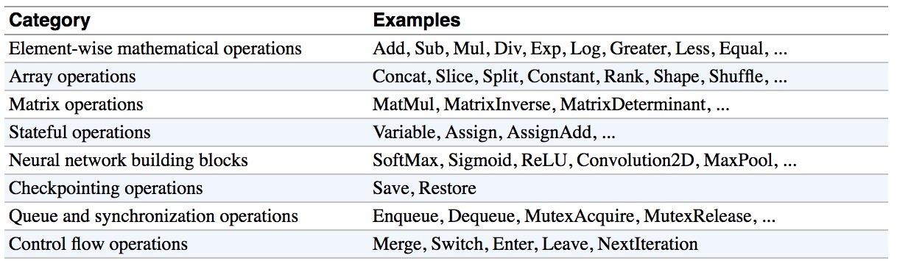
Tensorflow Operations

Slide 73
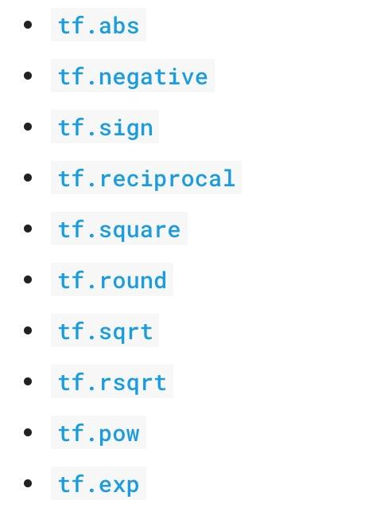
Tensorflow Arithmetic Operations

Slide 74
Agenda
Why Tensorflow ?
Computational Graph and Sessions
Basic Operations in Tensorflow
Auto-Diff and Optimizers
Visualization
Examples
Model Management

Slide 75
Auto-Diff
Tensorflow provide Auto-Diff Api to help us to train our machine learning model. Furthermore, in the module
tf.train
tensorflow provides a lot of state-of-art optimizers for us to use.
Example:
optimizer = tf.train.GradientDescentOptimizer(learning_rate=0.001).minimize(loss)
_, l = sess.run([optimizer, loss], feed_dict={X: x, Y:y})
Session looks at all trainable variables that loss depends on and update them

Slide 76
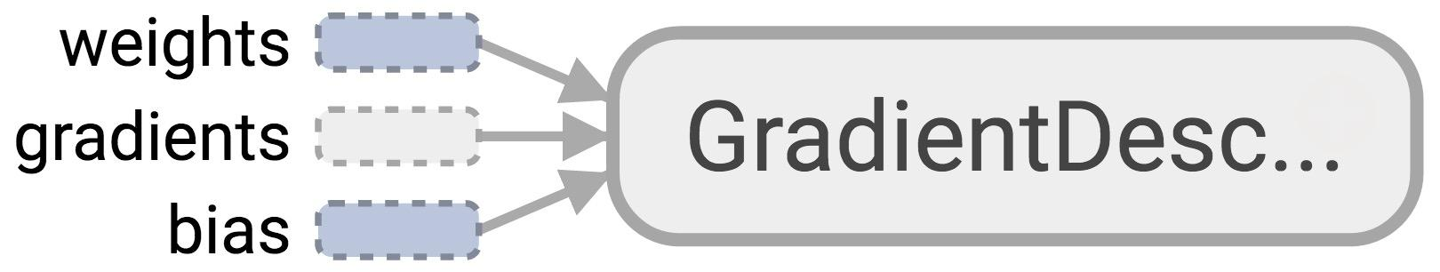
Optimizer
Session looks at all trainable variables that optimizer depends on and update them

Slide 77
How to Freeze Some Variables?
tf.Variable(initial_value=None, trainable=True,...)
Specify if a variable should be trained or not. By default, all variables are trainable.

Slide 78
Optimizers in Tensorflow
tf.train.GradientDescentOptimizer
tf.train.AdagradOptimizer
tf.train.MomentumOptimizer
tf.train.AdamOptimizer
tf.train.RMSPropOptimizer
...

Slide 79
Agenda
Why Tensorflow ?
Computational Graph and Sessions
Basic Operations in Tensorflow
Auto-Diff and Optimizers
Visualization
Examples
Structure Your Model

Slide 80
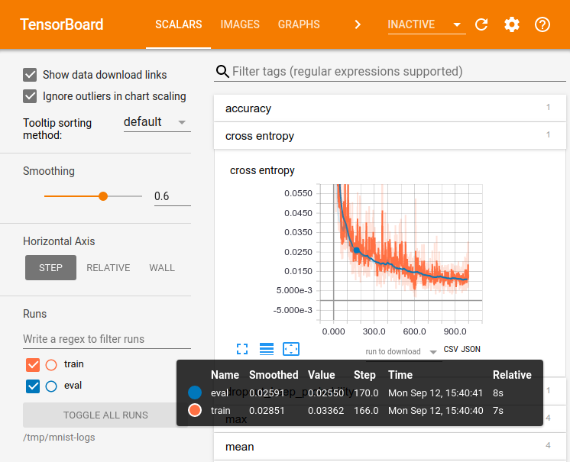
Tensorboard
Tensorboard is a suite of visualization tools in Tensorflow framework. You can use TensorBoard to visualize your TensorFlow graph, plot quantitative metrics about the execution of your graph, and show additional data like images that pass through it.
Image from Tensorflow

Slide 81
Visualize Your Graph With Tensorboard
import tensorflow as tf
a = tf.constant(2) b = tf.constant(3) x = tf.add(a, b)
writer = tf.summary.FileWriter('./graphs', tf.get_default_graph()) with tf.Session() as sess: # writer = tf.summary.FileWriter('./graphs', sess.graph) print(sess.run(x)) writer.close() # close the writer when you’re done using it
Create the summary writer after graph definition and before running your session

Slide 82
Launch Tensorboard
Go to terminal, run:
$ python3 [yourprogram].py $ tensorboard --logdir="./graphs" --port 6006
Then open your browser and go to: http://localhost:6006/
In Python Notebook:
>> !python3 [yourprogram].py
>> !tensorboard --logdir="./graphs" --port 6006

Slide 83
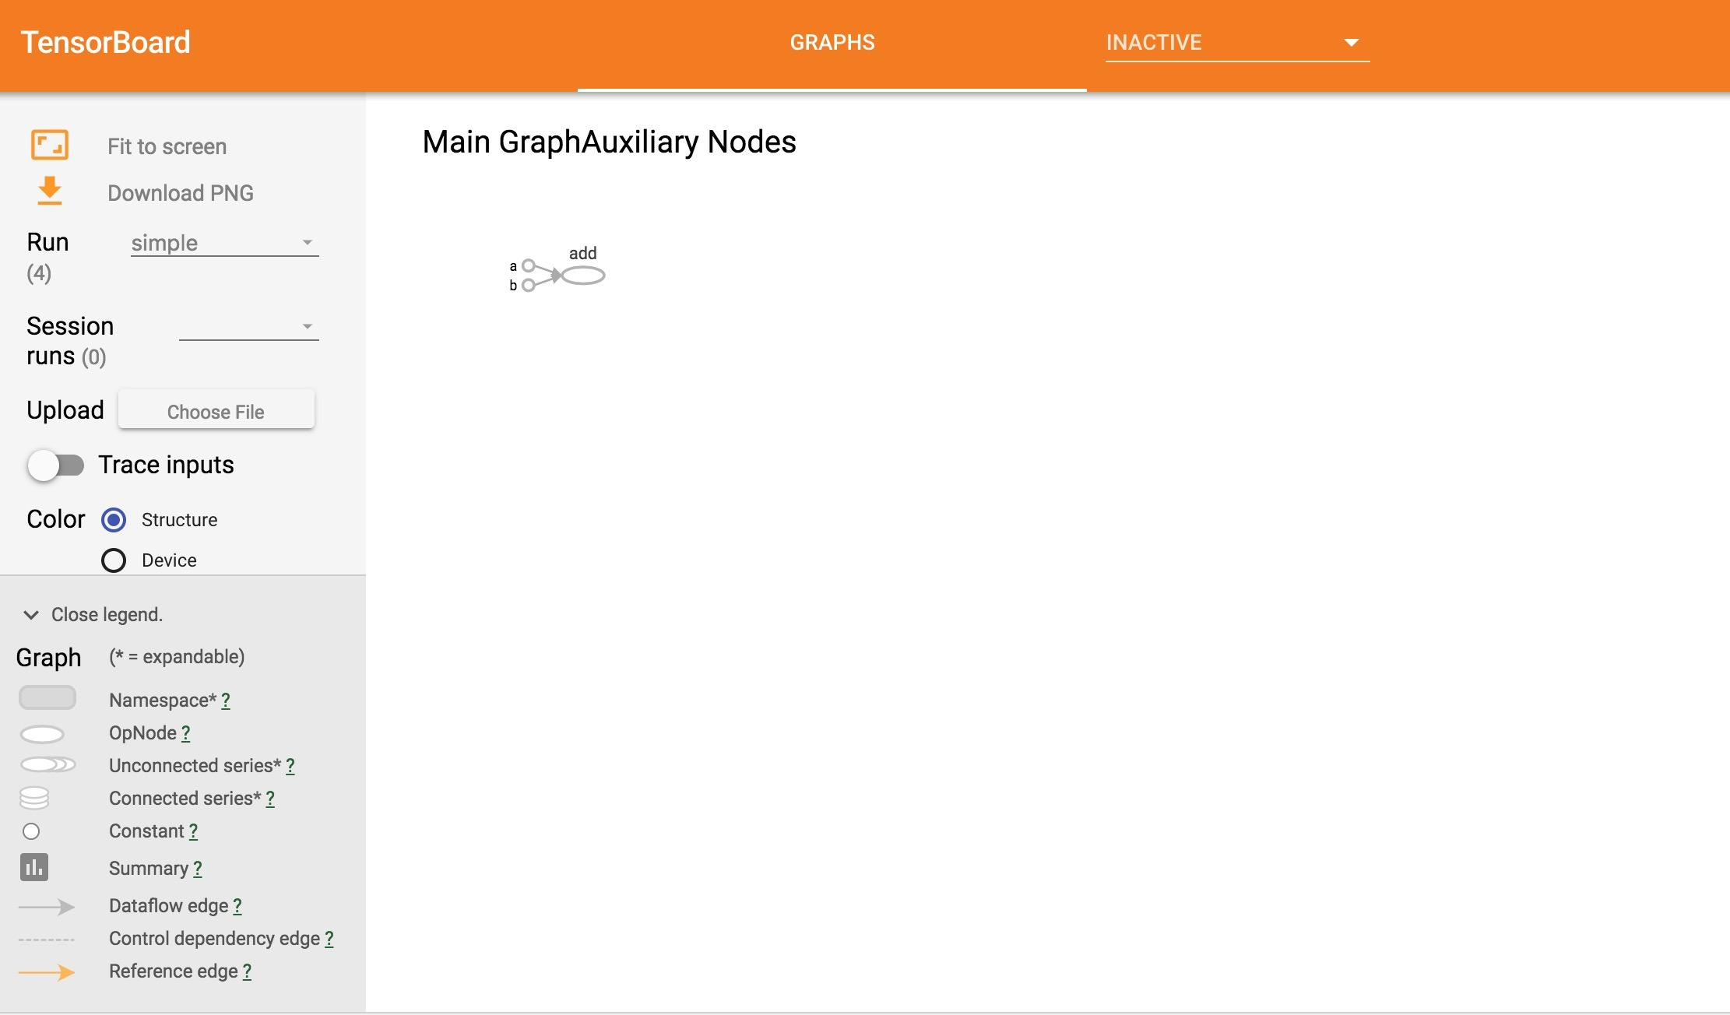

Slide 84
Agenda
Why Tensorflow ?
Computational Graph and Sessions
Basic Operations in Tensorflow
Auto-Diff and Optimizers
Visualization
Examples
Model Management

Slide 85
Standard Machine Learning Steps
Feature
Engineering
Data
Model

Slide 86
Neural Networks
Hidden Layers
Classifier
Data
Feature Extractors

Slide 87

Two Layers Neural Network in Tensorflow

Slide 88
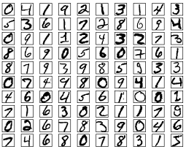
MNIST Dataset
This example is using MNIST handwritten digits. The dataset contains 60,000 examples for training and 10,000 examples for testing. The digits have been size-normalized and centered in a fixed-size image (28x28 pixels) with values from 0 to 1. For simplicity, each image has been flattened and converted to a 1-D numpy array of 784 features (28*28).

Slide 89
Phase 1: Assemble Our Graph
Phase 2: use a session to execute operations in the graph.
See Notebook for Details

Slide 90
Agenda
Why Tensorflow ?
Computational Graph and Sessions
Basic Operations in Tensorflow
Auto-Diff and Optimizers
Visualization
Examples
Model Management

Slide 91
Structure Model
Phase 1 Assemble Computational Graph
1. Import data (with tf.data or placeholders)
2. Define the weights
3. Define the inference model
4. Define loss function
5. Define optimizer

Slide 92
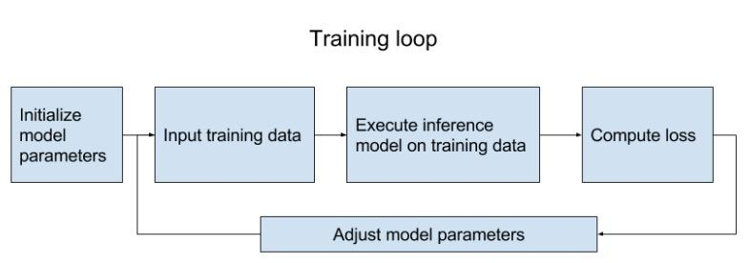
Structure Model
Phase 2 execute operations in the graph

Slide 93
Reusable Model
Define a class for your model
Set up your model in a collection (e.g. map)
If you want to really reuse a model (without rebuilding it)
For big models that take a long time to build, save the graph_def in a file and then load it

Slide 94
Model Class
class Two_Layer_NN:
""" Build the graph for two layer neural network model """
def __init__(self, params):
pass
def _import_data(self):
""" Step 1: import data """
pass
def _create_embedding(self):
""" Step 2: define weights."""
pass
def _create_loss(self):
""" Step 3 + 4: define the inference + the loss function """
pass
def _create_optimizer(self):
""" Step 5: define optimizer """
pass

Slide 95
tf.train.Saver
tf.train.Saver.save(sess, save_path, global_step=None...)
tf.train.Saver.restore(sess, save_path)

Slide 96
Save Parameters Every k-Steps
# define model
model = My_Model(params)
# create a saver object
saver = tf.train.Saver()
with tf.Session() as sess:
for step in range(training_steps):
sess.run([optimizer])
# save model every 1000 steps
if (step + 1) % 1000 == 0:
saver.save(sess,
'checkpoint_directory/model_name',
global_step=step)

Slide 97
Restore Variables
saver = tf.train.Saver()
saver.restore(sess, 'checkpoints/name_of_the_checkpoint')
Still Need to Build the Graph First!!!

Slide 98
tf.summary
Visualize our summary statistics during our training
tf.summary.scalar
tf.summary.histogram
tf.summary.image

Slide 99
Create Summaries
with tf.name_scope("summaries"):
tf.summary.scalar("loss", self.loss)
tf.summary.scalar("accuracy", self.accuracy)
tf.summary.histogram("histogram loss", self.loss)
summary_op = tf.summary.merge_all()

Slide 100
Run Them!
with tf.Session() as sess:
loss_batch, _, summary = sess.run([loss,
optimizer,
summary_op])

Slide 101
Write Summaries to File
writer = tf.summary.FileWriter('./graphs', sess.graph)
writer.add_summary(summary, global_step=step)
You Can Visualize Your Training Process on Tensorboard Real-Time Now!!!

Slide 102
What’s the Future?
Eager Execution

Slide 103
Why Eager Execution ?
Static Graphs are ...
Optimizable
automatic buffer reuse
constant folding
inter-op parallelism
automatic trade-off between compute and memory
Deployable
the Graph is an intermediate representation for models
Rewritable
experiment with automatic device placement or quantization

Slide 104
Why Eager Execution ?
But ...
Difficult to debug
errors are reported long after graph construction
execution cannot be debugged with pdb or print statements
Un-Pythonic
writing a TensorFlow program is an exercise in metaprogramming
control flow (e.g., tf.while_loop) differs from Python
can't easily mix graph construction with custom data structures

Slide 105
What is Eager Execution ?
"A NumPy-like library for numerical computation with support for GPU acceleration and automatic differentiation, and a flexible platform for machine learning research and experimentation."
the eager execution user guide

Slide 106
Enable Eager Execution
import tensorflow as tf
tf.enable_eager_execution()

Slide 107
Illustrate Eager Execution via Simple Examples
See Python Notebook

Slide 108

A Scalable Interface

Slide 109
Why Keras ？
Keras prioritizes developer experience
Keras has broad adoption in the industry and the research community
Keras makes it easy to turn models into products
Keras supports multiple backend engines and does not lock you into one ecosystem
Keras has strong multi-GPU support and distributed training support

Slide 110
Why Keras ？
Keras prioritizes developer experience
Keras has broad adoption in the industry and the research community
Keras makes it easy to turn models into products
Keras supports multiple backend engines and does not lock you into one ecosystem
Keras has strong multi-GPU support and distributed training support

Slide 111

What is Keras ?
Keras is an API designed for human beings, not machines.

Slide 112


X

Slide 113
How to use Keras: Learn from Example
import keras

Slide 114

Keras API Overview: Sequential API
The Sequential Model is a linear stack of layers

Slide 115
Sequential Model API
Initialize sequential model
Add layers to model
Compile model
Train and Evaluate

Slide 116

Convolution

Slide 117
Convolution Layer
32x32x3 image
Filters always extend the full depth of the input volume
32
height
5x5x3 filter
Convolve the filter with the image
i.e. “slide over the image spatially, computing dot products”
32
width
3
depth

Slide 118
Convolution Layer
activation maps
32x32x3 image
5x5x3 filter
32
28
convolve (slide) over all spatial locations
32
28
3
1
‹#›

Slide 119

Convolution Layer
Output
Filter
Input
Padding

Slide 120
Convolution Layer
activation maps
32
28
Convolution Layer
32
28
3
6
We stack these up to get a new “image” of size 28x28x6!

Slide 121
Convolution Layer
32
28
CONV,
ReLU
e.g. 6 5x5x3 filters
32
28
3
6

Slide 122

Pooling Layer

Slide 123
Max Pooling
Single depth slice
1 | 1 | 2 | 4
5 | 6 | 7 | 8
3 | 2 | 1 | 0
1 | 2 | 3 | 4
x
max pool with
2x2 filters and stride 2
6 | 8
3 | 4
y
‹#›
Slide credit: CS231n Lecture 7

Slide 124

Dropout
Very simple way to prevent overfitting
The ideas comes from Bagging:
Sample training data and train several different classifiers
Classify test instance with entire ensemble of classifiers
Vote across classifiers for final decision

Slide 125



Dropout

Slide 126

Dropout
Due to randomness, the drop nodes changes for each input
BP is effectively performed only over the remaining network
For closed nodes, the gradients are zero

Slide 127

Dropout
Dropout forces the neuros to learn “rich” and redundant pattern
Without dropout, a layer may just clone its input to output.
Dropout forces the neuros to learn denser pattern

Slide 128


Dropout During Test
Kind of average voting

Slide 129

Illustrate Sequential Model via Two Layers CNN

Slide 130
Overview: Functional API
Initialize model
Build model vie functional APIs
Compile model
Train and Evaluate

Slide 131
Why Functional APIs ?
Flexible and friendly for complicated models
Handle shared layers
Handle multi-inputs & multi-outputs models

Slide 132
Reimplement via Functional APIs

Slide 133
What’s More ?
Read More in Keras Documentation
https://keras.io/

Slide 134
References & Resources
Tensorflow Tutorial: https://www.tensorflow.org/tutorials/
CS 20: http://web.stanford.edu/class/cs20si/syllabus.html
Model Zoo: https://github.com/tensorflow/models/tree/master/research
YiDu AI NLP Module: https://yiduai.sg/training-program-advance-level/ (Next Batch Comming Next January) CNN Module: Coming in Next January

Slide 135

Feedback
Please Scan, Fill in the form and Submit.

Slide 136


